Slide 1
Web Science:
kNN and Summary
(Part 1 - Intro to kNN)
CS 432/532
Old Dominion University
Permission has been granted to use these slides from Frank McCown, Michael L. Nelson, Alexander Nwala, Michele C. Weigle
This work is licensed under a Creative Commons Attribution-NonCommercial-ShareAlike 3.0 Unported License

Slide 2
Main reference:
Ch 8 from Programming Collective Intelligence by Toby Segaran
(abbreviated as PCI)
code available at Ch 8 GitHub repo

Slide 3
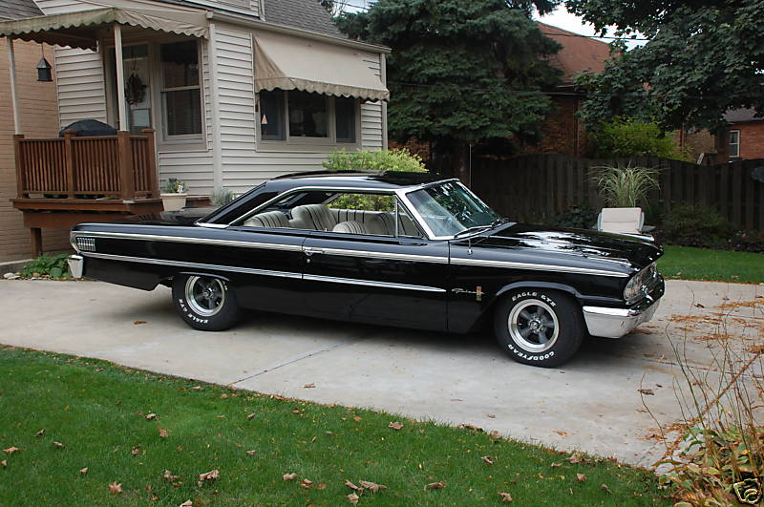
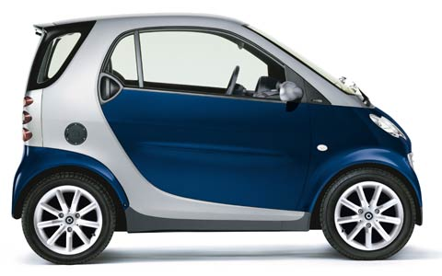
Some Evaluations are Simple…
vs.
Which is a classic car and which is a tiny car?

Slide 4
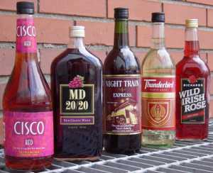

Some Evaluations are More Complex
vs.
How much should a particular bottle of wine cost?
what is its quality?
how old is it?

Slide 5
Some Evaluations are More Complex
vs.
Chapter 8 price model for wines: price = f(rating,age)
wines have a peak age
far into the future for good wines (high rating)
nearly immediate for bad wines (low rating)
wines can gain 5X original value at peak age
wines go bad 5 years after peak age

Slide 6
Some Evaluations are More Complex
def wineprice(rating,age):
peak_age=rating-50
# Calculate price based on rating
price=rating/2
if age>peak_age:
# Past its peak, goes bad in 5 yrs
price=price*(5-(age-peak_age))
else:
# Increases to 5x original value
# as it approaches its peak
price=price*(5*((age+1)/peak_age))
if price<0: price=0
return price
price = f(rating,age)
wines have a peak age
far into the future for good wines (high rating)
nearly immediate for bad wines (low rating)
wines can gain 5X original value at peak age
wines go bad 5 years after peak age
numpredict.py

Slide 7
Generate Some Wine Prices
wineprice(rating,age)
wineprice(95.0,3.0)
21.111111111111114
wineprice(95.0,8.0)
47.5
wineprice(99.0,1.0)
10.102040816326529
wineprice(20.0,1.0)
0
wineprice(30.0,1.0)
0
wineprice(50.0,1.0)
112.5
wineprice(50.0,2.0)
100.0
wineprice(50.0,3.0)
87.5
good wine, but not peak age = low price
skunk water
middling wine, but peak age = high price

Slide 8
Build the Wine Price Dataset
wineset1()
data[0]
{'input': (89.232627562980568, 23.392312984476838), 'result': 157.65615979190267}
data[1]
{'input': (59.87004163297604, 2.6353185389295875), 'result': 50.624575737257267}
data[2]
{'input': (95.750031143736848, 29.800709868119231), 'result': 184.99939310081996}
data[3]
{'input': (63.816032861417639, 6.9857271772707783), 'result': 104.89398176429833}
data[4]
{'input': (79.085632724279833, 36.304704141161352), 'result': 53.794171791411422}
def wineset1():
rows=[]
for i in range(300):
# Create a random age and rating
rating=random()*50+50
age=random()*50
# Get reference price
price=wineprice(rating,age)
# Add some noise
#price*=(random()*0.2+0.9)
price*=(random()*0.4+0.8)
# Add to the dataset
rows.append({'input': (rating,age),
'result': price})
return rows
numpredict.py

Slide 9
Predict How Much is This Bottle Worth
Use k-nearest neighbors algorithm
Find the k “nearest neighbors” to the item in question and average their prices. Your bottle is probably worth what the others are worth.
Questions:
how big should k be?
what dimensions should be used to judge “nearness”

Slide 10
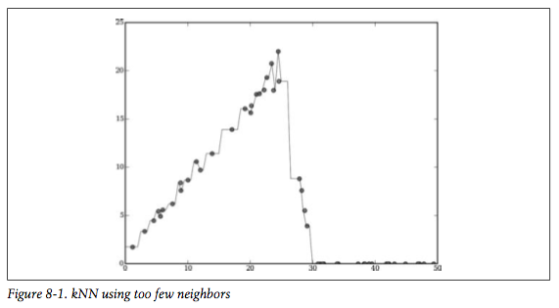
k=1, Too Small
price
age
From PCI

Slide 11
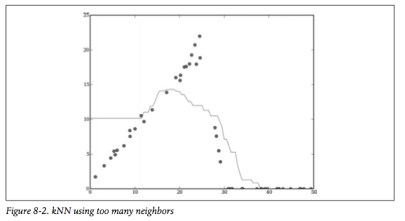
k=20, Too Big
price
age
From PCI

Slide 12
Define “Nearness” as f(rating,age)
data[0]: {'input': (89.232627562980568, 23.392312984476838), 'result': 157.65615979190267}
data[1]: {'input': (59.87004163297604, 2.6353185389295875), 'result': 50.624575737257267}
data[2]: {'input': (95.750031143736848, 29.800709868119231), 'result': 184.99939310081996}
data[3]: {'input': (63.816032861417639, 6.9857271772707783), 'result': 104.89398176429833}
data[4]: {'input': (79.085632724279833, 36.304704141161352), 'result': 53.794171791411422}
euclidean(data[0]['input'],data[1]['input'])
35.958507629062964
euclidean(data[0]['input'],data[2]['input'])
9.1402461702479503
euclidean(data[0]['input'],data[3]['input'])
30.251931245339232
euclidean(data[0]['input'],data[4]['input'])
16.422282108155486
euclidean(data[1]['input'],data[2]['input'])
45.003690219362205
euclidean(data[1]['input'],data[3]['input'])
5.8734063451707224
euclidean(data[1]['input'],data[4]['input'])
38.766821739987471
def euclidean(v1,v2):
d=0.0
for i in range(len(v1)):
d+=(v1[i]-v2[i])**2
return math.sqrt(d)
numpredict.py

Slide 13
Calculate Distance to Every Item
def getdistances(data,vec1):
distancelist=[]
# Loop over every item in the dataset
for i in range(len(data)):
vec2=data[i]['input']
# Add the distance and the index
distancelist.append((euclidean(vec1,vec2),i))
# Sort by distance
distancelist.sort()
return distancelist
numpredict.py

Slide 14
kNN Estimator
knnestimate(data,(95.0,3.0))
21.635620163824875
wineprice(95.0,3.0)
21.111111111111114
knnestimate(data,(95.0,15.0))
74.744108153418324
knnestimate(data,(95.0,25.0))
145.13311902177989
knnestimate(data,(99.0,3.0))
19.653661909493177
knnestimate(data,(99.0,15.0))
84.143397370311604
knnestimate(data,(99.0,25.0))
133.34279965424111
knnestimate(data,(99.0,3.0),k=1)
22.935771290035785
knnestimate(data,(99.0,3.0),k=10)
29.727161237156785
knnestimate(data,(99.0,15.0),k=1)
58.151852659938086
knnestimate(data,(99.0,15.0),k=10)
92.413908926458447
def knnestimate(data,vec1,k=5):
# Get sorted distances
dlist=getdistances(data,vec1)
avg=0.0
# Average of the top k results
for i in range(k):
idx=dlist[i][1]
avg+=data[idx]['result']
avg=avg/k
return avg
mo neighbors,
mo problems
numpredict.py

Slide 15
Should All Neighbors Count Equally?
getdistances() sorts the neighbors by distances, but those distances could be:
1, 2, 5, 11, 12348, 23458, 456599
We’ll notice a big change going from k=4 to k=5
How can we weight the 7 neighbors above accordingly?

Slide 16
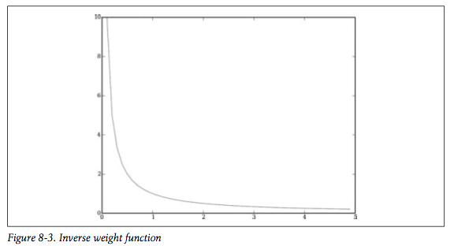
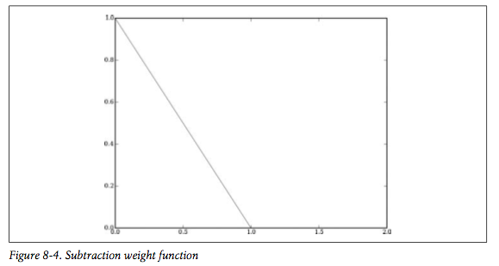
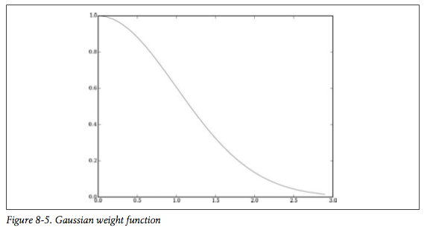
Weight Functions
Figures 8-3, 8-4, 8-5 from PCI
weight
def inverseweight(dist,num=1.0,const=0.1):
return num/(dist+const)
Falls off too quickly
distance
def subtractweight(dist,const=1.0):
if dist>const:
return 0
else:
return const-dist
Goes to Zero
def gaussian(dist,sigma=5.0):
return math.e**(-dist**2/(2*sigma**2))
Falls Slowly, Doesn’t Hit Zero
numpredict.py

Slide 17
Weighted kNN Estimator
def weightedknn(data,vec1,k=5,weightf=gaussian):
# Get distances
dlist=getdistances(data,vec1)
avg=0.0
totalweight=0.0
# Get weighted average
for i in range(k):
dist=dlist[i][0]
idx=dlist[i][1]
weight=weightf(dist)
avg+=weight*data[idx]['result']
totalweight+=weight
if totalweight==0: return 0
avg=avg/totalweight
return avg
def knnestimate(data,vec1,k=5):
# Get sorted distances
dlist=getdistances(data,vec1)
avg=0.0
# Average of the top k results
for i in range(k):
idx=dlist[i][1]
avg+=data[idx]['result']
avg=avg/k
return avg
numpredict.py

Slide 18
Weighted vs. Non-Weighted
wineprice(95.0,3.0)
21.111111111111114
knnestimate(data,(95.0,3.0))
21.635620163824875
weightedknn(data,(95.0,3.0))
21.648741297049899
wineprice(95.0,15.0)
84.444444444444457
knnestimate(data,(95.0,15.0))
74.744108153418324
weightedknn(data,(95.0,15.0))
74.949258534489346
wineprice(95.0,25.0)
137.2222222222222
knnestimate(data,(95.0,25.0))
145.13311902177989
weightedknn(data,(95.0,25.0))
145.21679590393029
knnestimate(data,(95.0,25.0),k=10)
137.90620608492134
weightedknn(data,(95.0,25.0),k=10)
138.85154438288421

Slide 19
Web Science:
kNN and Summary
(Part 2 - Validating and Optimizing kNN)
CS 432/532
Old Dominion University
Permission has been granted to use these slides from Michele C. Weigle
This work is licensed under a Creative Commons Attribution-NonCommercial-ShareAlike 3.0 Unported License

Slide 20
Main reference:
Ch 8 from Programming Collective Intelligence by Toby Segaran
(abbreviated as PCI)
code available at Ch 8 GitHub repo

Slide 21
Cross-Validation
Testing all the combinations would be tiresome…
We cross validate our data to see how our method is performing:
divide our 300 bottles into training data and test data (typically something like a (0.95,0.05) split)
train the system with our training data, then see if we can correctly predict the results in the test data (where we already know the answer) and record the errors
repeat n times with different training/test partitions

Slide 22
Cross-Validation Functions
dividedata(data, test=0.05) - divides data into trainset and testset, test is the portion of the data that should be used for the test set
testalgorithm(algf, trainset, testset) - tests the function algf using the trainset and a query from testset, runs for all items in testset
crossvalidate(algf, data, trials=100, test=0.05) - divides data and runs testalgorithm() trials number of times and reports the average error (totalerror / trials)
numpredict.py

Slide 23
Preparing for Cross-Validation
def knn3(d,v): return knnestimate(d,v,k=3)
def knn1(d,v): return knnestimate(d,v,k=1)
def wknn3(d,v): return weightedknn(d,v,k=3)
def wknn1(d,v): return weightedknn(d,v,k=1)
def wknn5inverse(d,v): return weightedknn(d,v,weightf=inverseweight)

Slide 24
Cross-Validating kNN and WkNN
crossvalidate(knnestimate,data) # k=5
357.75414919641719
crossvalidate(knn3,data)
374.27654623186737
crossvalidate(knn1,data)
486.38836851997144
crossvalidate(weightedknn,data) # k=5
342.80320831062471
crossvalidate(wknn3,data)
362.67816434458132
crossvalidate(wknn1,data)
524.82845502785574
crossvalidate(wknn5inverse,data)
342.68187472350417

Slide 25
Heterogeneous Data
Suppose that in addition to rating & age, we collected:
bottle size (in ml)
375, 750, 1500, 3000
(book code goes to 3000, github code to 1500)
Wine bottle sizes (Wikipedia)
the # of aisle where the wine was bought (aisle 2, aisle 9, etc.)
def wineset2():
rows=[]
for i in range(300):
rating=random()*50+50
age=random()*50
aisle=float(randint(1,20))
bottlesize=[375.0,750.0,1500.0][randint(0,2)]
price=wineprice(rating,age)
price*=(bottlesize/750)
price*=(random()*0.2+0.9)
rows.append({'input':
(rating,age,aisle,bottlesize),
'result':price})
return rows
numpredict.py

Slide 26
Vintage #2
data2 = wineset2()
data2[0]
{'input': (54.165108104770141, 34.539865790286861, 19.0, 1500.0), 'result': 0.0}
data2[1]
{'input': (85.368451290310119, 20.581943831329454, 7.0, 750.0), 'result': 138.67018277159647}
data2[2]
{'input': (70.883447179046527, 17.510910062083763, 8.0, 375.0), 'result': 83.519907955896613}
data2[3]
{'input': (63.236220974521459, 15.66074713248673, 9.0, 1500.0), 'result': 256.55497402767531}
data2[4]
{'input': (51.634428621301851, 6.5094854514893496, 6.0, 1500.0), 'result': 120.00849381080788}
crossvalidate(knn3,data) # from wineset1()
374.27654623186737
crossvalidate(knn3,data2)
1197.0287329391431
crossvalidate(weightedknn,data) # from wineset1()
342.80320831062471
crossvalidate(weightedknn,data2)
1001.3998202008664
We have more data -- why are the errors larger?

Slide 27
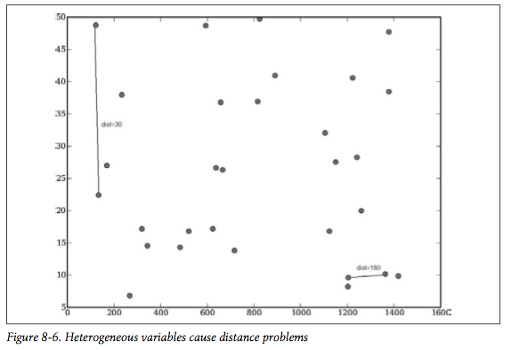
Differing Data Scales
age
dist=30
dist=180
bottlesize
From PCI

Slide 28
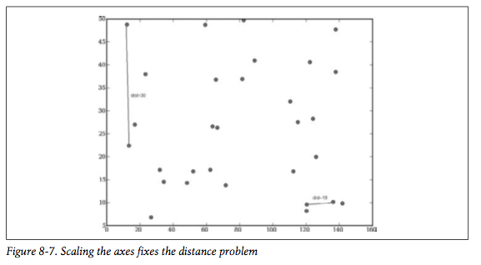
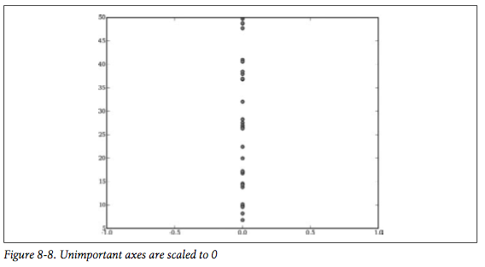
Rescaling The Data
age
age
distance=18
bottlesize
aisle
Rescale ml by 0.1
Rescale aisle by 0.0
From PCI

Slide 29
Cross-Validating Our Scaled Data
def rescale(data,scale):
scaleddata=[]
for row in data:
scaled=[scale[i]*row['input'][i] for i in range(len(scale))]
scaleddata.append({'input':scaled,'result':row['result']})
return scaleddata
crossvalidate(knn3,data2)
1197.0287329391431
crossvalidate(weightedknn,data2)
1001.3998202008664
sdata=rescale(data2,[10,10,0,0.5])
crossvalidate(knn3,sdata)
874.34929987724752
crossvalidate(weightedknn,sdata)
1137.6927754808073
sdata=rescale(data2,[15,10,0,0.1])
crossvalidate(knn3,sdata)
1110.7189445981378
crossvalidate(weightedknn,sdata)
1313.7981751958403
sdata=rescale(data2,[10,15,0,0.6])
crossvalidate(knn3,sdata)
948.16033679019574
crossvalidate(weightedknn,sdata)
1206.6428136396851
2nd and 3rd guesses are worse than the initial guess --
but how can we tell if the initial guess is “good”?
numpredict.py

Slide 30
Preparing for Optimization
def createcostfunction(algf,data):
def costf(scale):
sdata=rescale(data,scale)
return crossvalidate(algf,sdata,trials=20)
return costf
weightdomain=[(0,20)]*4 # book version, code has [(0,10)]*4
numpredict.py

Slide 31
Optimizing The Scales
import optimization # using the ch 5 version, not the ch 8 version!
costf=createcostfunction(knnestimate,data)
optimization.annealingoptimize(weightdomain,costf,step=2)
[4, 8.0, 2, 4.0]
optimization.annealingoptimize(weightdomain,costf,step=2)
[4, 8, 4, 4]
optimization.annealingoptimize(weightdomain,costf,step=2)
[6, 10, 2, 4.0]
the book got [11,18,0,6] --
the last solution is close, but we are hoping to see 0 for aisle…

Slide 32
Optimizing - Genetic Algorithm
optimization.geneticoptimize(weightdomain,costf,popsize=5)
1363.57544567
1509.85520291
1614.40150619
1336.71234577
1439.86478765
1255.61496037
1263.86499276
1447.64124381
[lots of lines deleted]
1138.43826351
1215.48698063
1201.70022455
1421.82902056
1387.99619684
1112.24992339
1135.47820954
[5, 6, 1, 9]
the book got [20,18,0,12] on this one

Slide 33
Web Science:
kNN and Summary
(Part 3 - Algorithm Summary)
CS 432/532
Old Dominion University
Permission has been granted to use these slides from Michele C. Weigle
This work is licensed under a Creative Commons Attribution-NonCommercial-ShareAlike 3.0 Unported License

Slide 34
Main reference:
Ch 12 from Programming Collective Intelligence by Toby Segaran
(abbreviated as PCI)

Slide 35
PCI Algorithms
Clustering
Hierarchical Clustering - Ch 3
K-Means Clustering - Ch 3
Multidimensional Scaling - Ch 3
Classification
Bayesian Classifier - Ch 6
Decision Tree Classifier - Ch 7 - not covered
Neural Networks - Ch 4 - not covered
Support-Vector Machines (SVM) - Ch 9 - not covered
Prediction
k-Nearest Neighbors - Ch 8
Optimization - Ch 5 - not covered, but used

Slide 36
Clustering
Cluster a set of data into similar groups
Unsupervised learning
no training data required
no predictions made
Hierarchical clustering
K-Means clustering

Slide 37
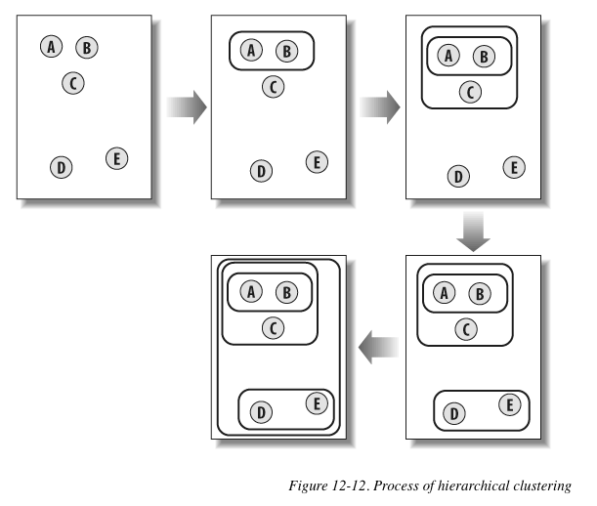

Hierarchical Clustering
Works when there are numerical properties
Start with all items in their own clusters
progressively merge similar clusters
Result can be shown as a dendrogram
From PCI

Slide 38
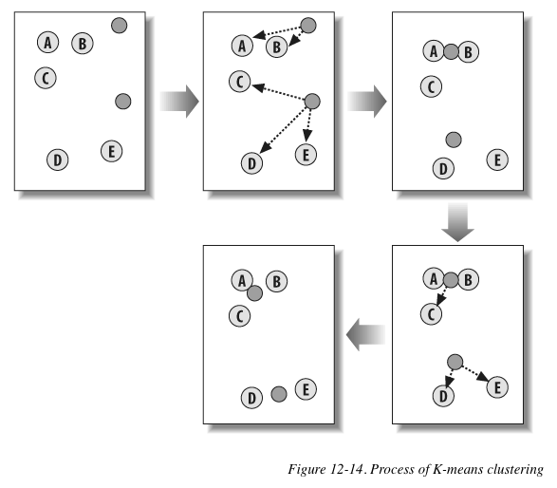
K-Means Clustering
K-Means separates the data into groups
Must decide how many groups (K) before the process begins
Division is performed by measuring the distance between items and centroids (located at the mean position of the items in the group)
From PCI

Slide 39
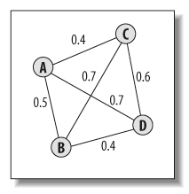
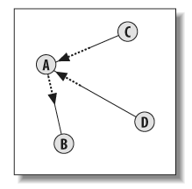
Multidimensional Scaling (MDS)
Allows to convert multiple dimensions to 2D for plotting
Distance in 2D should be similar to distance calculated in all dimensions
Nodes moved according to combination of forces from other nodes
From PCI

Slide 40
Classification
Classify data into known categories
Supervised learning
training data consists of data and correct classification
testing data is what is being classified
Bayesian Classifier
Decision Tree Classifier
Neural Networks
Support Vector Machines

Slide 41
Bayesian Classifier
Data is divided up into features that can be marked as present or absent
Uses Bayes’ Rule to compute probabilities for each item (based on the probability of the features)
Trained classifier - list of features and their probabilities
no need to store the original data once trained

Slide 42
Strengths/Weaknesses of
Bayesian Classifier
Strengths
Fast
Supports incremental training
Easy to interpret the trained model
Weaknesses
Cannot deal with combinations of features

Slide 43
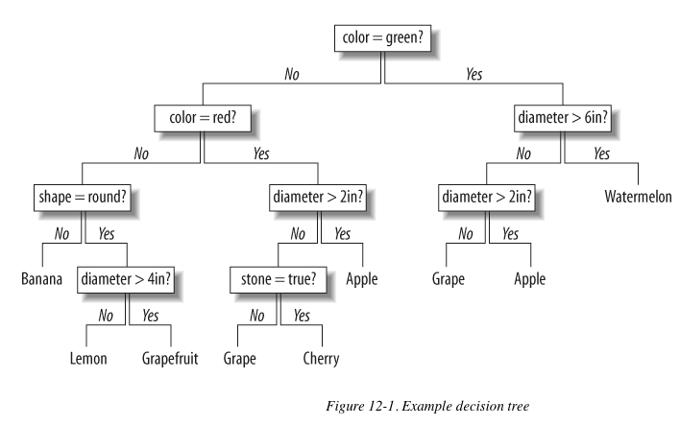
Decision Tree Classifier
Once model is trained, classifying is following the tree
Training is based on dividing up data to maximize information gain
From PCI

Slide 44
Strengths/Weaknesses of
Decision Trees
Strengths
Easy to interpret the trained model
Brings important factors to the top of the tree
Can deal with combinations of variables
Weaknesses
Does not support incremental training

Slide 45
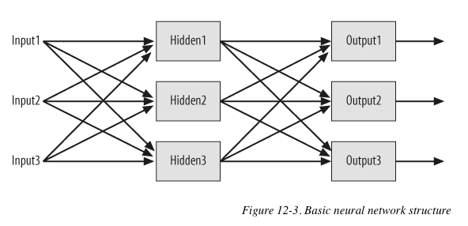
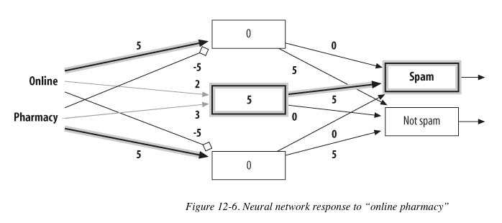
Neural Networks
Layer of input neurons that feed into one or more layers of hidden neurons
Outputs of one set of neurons are fed to the next layer
Can learn combinations that are important
Can be applied to classification and numerical prediction
From PCI

Slide 46
Strengths/Weaknesses of
Neural Networks
Strengths
Can handle complex nonlinear functions
Can discover dependencies between different inputs
Allows for incremental training
Weaknesses
Black box method - impossible to determine how the network came up with the answer
No definitive rules for choosing the training rate and network size for a given problem

Slide 47
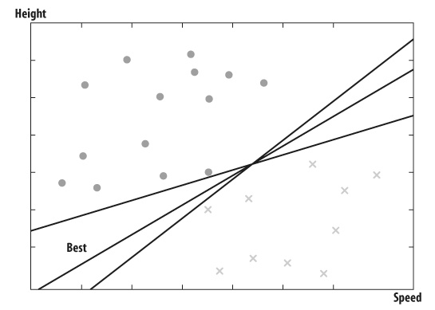
Support Vector Machines (SVM)
Take datasets with numerical inputs
Tries to predict categories
Builds a predictive model by finding the dividing line that separates the data most cleanly
Support vectors - points closest to the line
From PCI

Slide 48
Strengths/Weaknesses of
SVMs
Strengths
Very powerful classifier
After training, is very fast to classify
Can work with a mixture of categorical and numerical data
Weaknesses
Best parameters will be different for every dataset
Black box technique

Slide 49
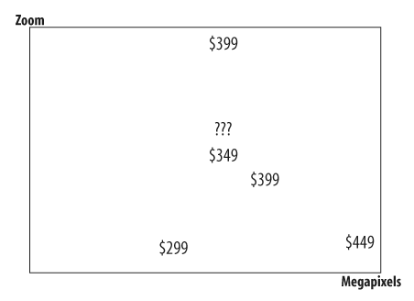
k-Nearest Neighbors (kNN)
Numerical prediction method
Take the new item and compare it to a set of known items
Averages the values of the k known items most similar for the prediction
From PCI

Slide 50
Strengths/Weaknesses of
kNN
Strengths
Can make numerical predictions in complex functions
Easy to interpret the results
Online technique - new data can be added at any time
Weaknesses
Requires all training data to be present
Finding correct scaling factors can be tedious

Slide 51
Optimization
Attempts to select values that minimize the output of a cost function
Cost function - returns a higher value for worse solutions and lower value for better solutions
Optimization functions use the cost function to test solutions and search possible solutions
Optimization algorithms (covered in PCI)
Simulated annealing
Genetic algorithms

Slide 52
PCI Algorithms
Clustering
Hierarchical Clustering - Ch 3
K-Means Clustering - Ch 3
Multidimensional Scaling - Ch 3
Classification
Bayesian Classifier - Ch 6
Decision Tree Classifier - Ch 7 - not covered
Neural Networks - Ch 4 - not covered
Support-Vector Machines (SVM) - Ch 9 - not covered
Prediction
k-Nearest Neighbors - Ch 8
Optimization - Ch 5 - not covered, but used

Slide 53
Objectives
Describe the main idea behind the k-nearest neighbor algorithm.
Describe the tradeoffs in setting the value of k (not too low, not too high).
Explain the benefits of weighted kNN.
Explain the purpose of cross-validation in evaluating prediction algorithms.
Explain the purpose of the cost function in optimization.

